Slide 1
Prediction of Change in Poverty Rate through American Community Survey Data

Slide 2
Can demographic information available through the American Community Survey predict change in the poverty rate?
Notes:
Rationale for the project

Slide 3
Data
Census data from the American Community Survey from 2015 and 2017
Includes racial and economic factors for each US Census tract
Raw data available here

Slide 4
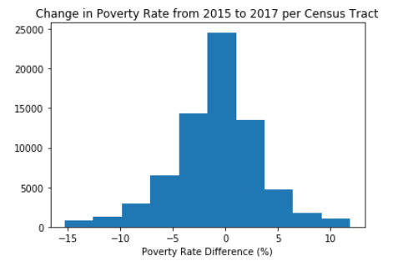

Slide 5
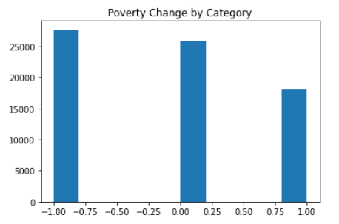
+1: >1.5% increase in poverty level from 2015 to 2017
0: no significant change in poverty level from 2015 to 2017
-1: >1.5% decrease in poverty level from 2015 to 2017

Slide 6
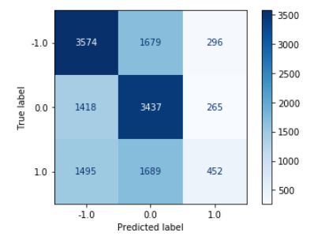
Logistic Regression

Slide 7
Logistic Regression

Slide 8
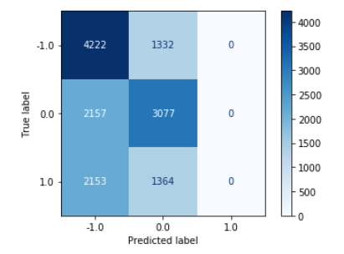
Random Forest Classification

Slide 9
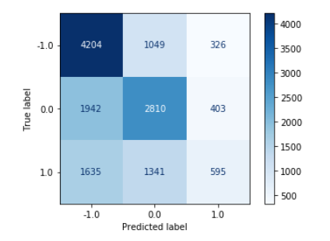
Gradient Boosting Classification

Slide 10
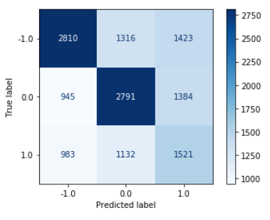
Logistic Regression with Oversampling

Slide 11
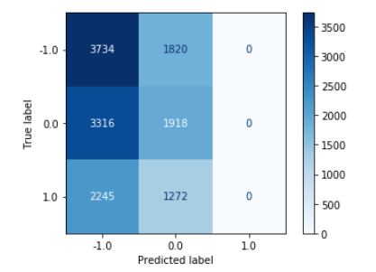
Random Forest Classification with Oversampling

Slide 12
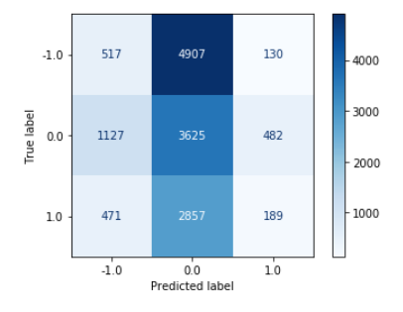
Gradient Boosting Classification with Oversampling

Slide 13
Impactful Variables
Decreasing Poverty Rate
Poverty rate
Percentage professionals
Percentage white
Median household income
Percentage employed
Increasing Poverty Rate
Income per capita
Percentage walking to work
Percentage US citizens

Slide 14
QUESTIONS?

Slide 15
THANK YOU!

